Slide 1
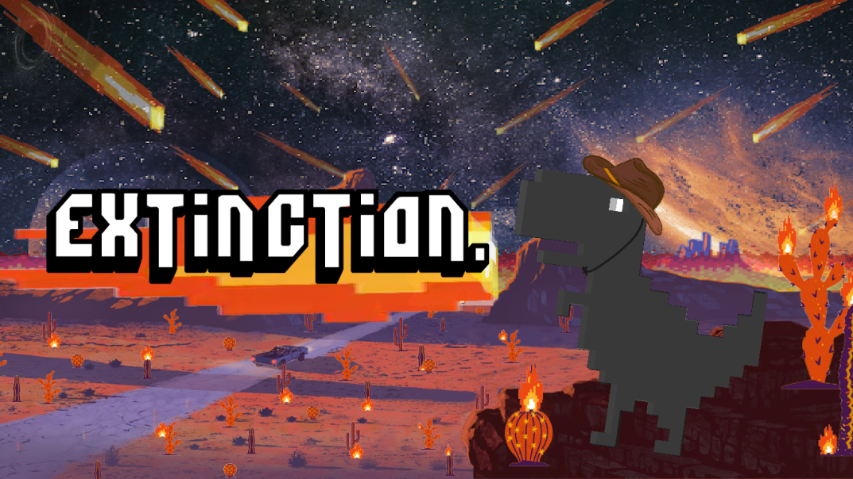
Hannah Gold
Ian McFarlin
Ismaeel Alalawi
Jack Halberian
Kakit Wong

Slide 2
Scenario
Researcher Doug of CIDAR lab was conducting research on synthetic biology, when suddenly something goes terribly wrong. The experimental fluid leaked, and flooded the labs. After drowning in the toxic liquid every genome in his body started to mutate. After mutating into a short-armed T-Rex, he rampaged the dry lands once covered by ocean. At this point an asteroid impact has become nothing more than a sunny day in the midst of August. Still holding onto his primal instinct he does whatever it takes to survive, so one day he may still see his family.
Notes:
Start off normal then get more dramatic as you go

Slide 3
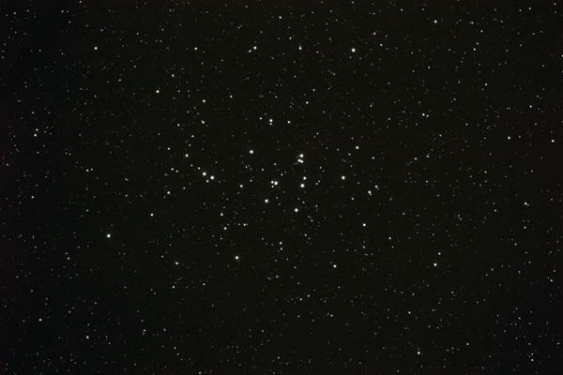
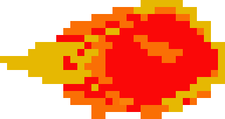
Goal/Motivations
Understand about sprites and how to implement them into Verilog
Create an original and interactive dino game
Learn how to utilize a VGA display
Understand collision logic and pseudo randomization

Slide 4

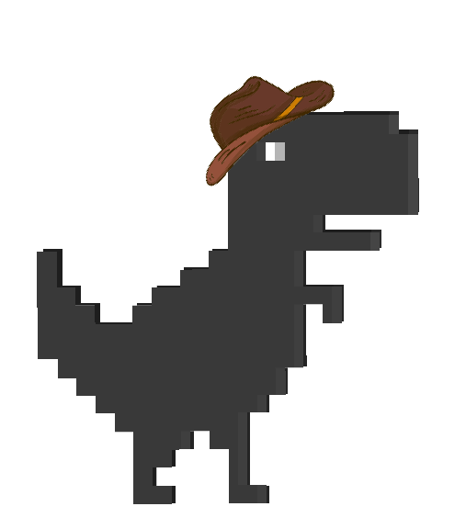
Functionality
VGA
After pressing a key on the keyboard the game will begin
The dino and cacti will appear on the screen
The asteroids will fall down “randomly”
Score
The value of the score will increase after pressing a key to begin
When the dino dies the timer stops, and that will be your score for that round
The score will reset after each game
Movement
The dino can me moved using the up, down, left, right using the keyboard

Slide 5

Specifications
Keyboard
User input to control the movement of the dino
VGA
Displays game properties such as the cacti, asteroids, dino, game score
Game Mechanics
Module to randomize the speed and direction of the asteroid
Module to change states of the sprites
Module to count the time passed using a 6.25 Mhz clock

Slide 6
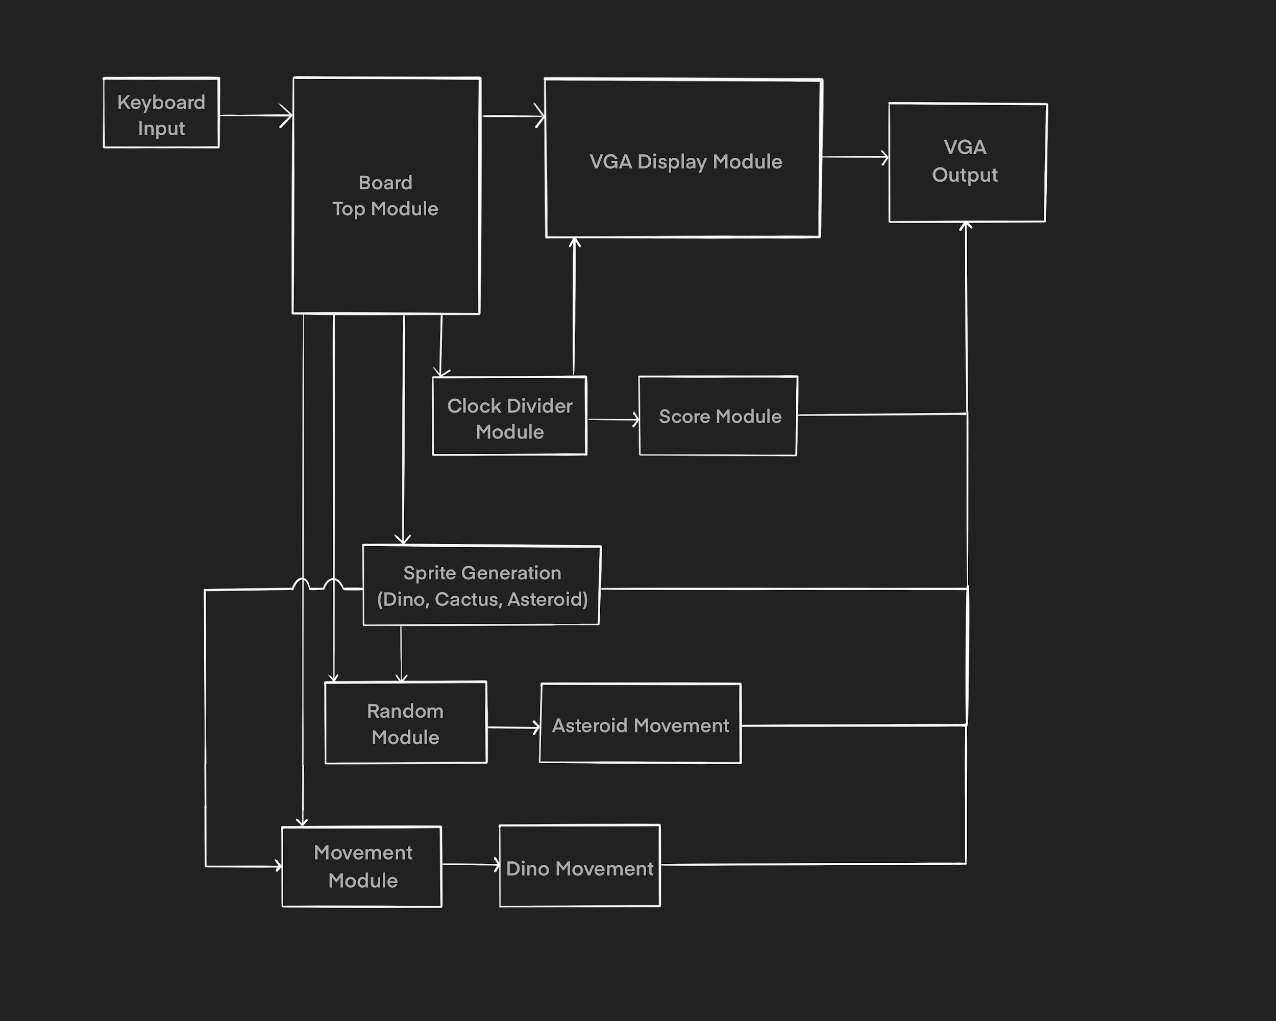
Block Diagram

Slide 7
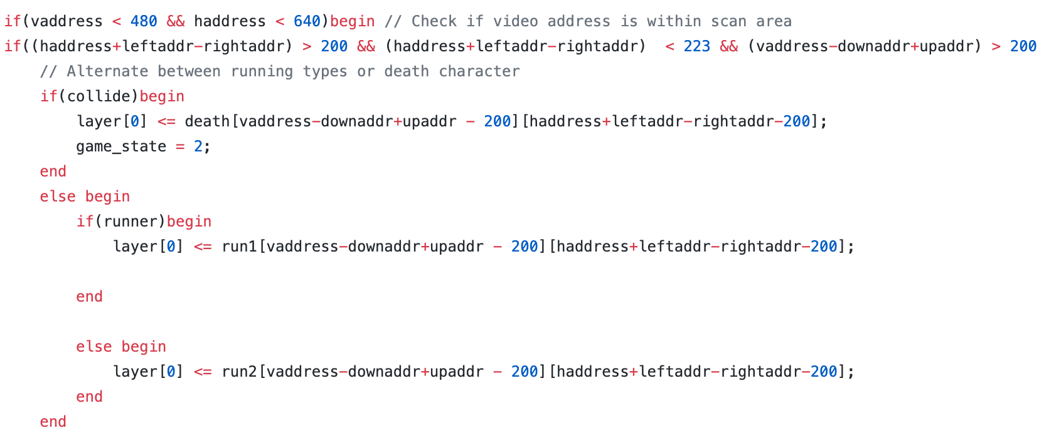
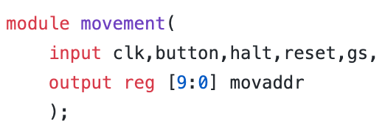
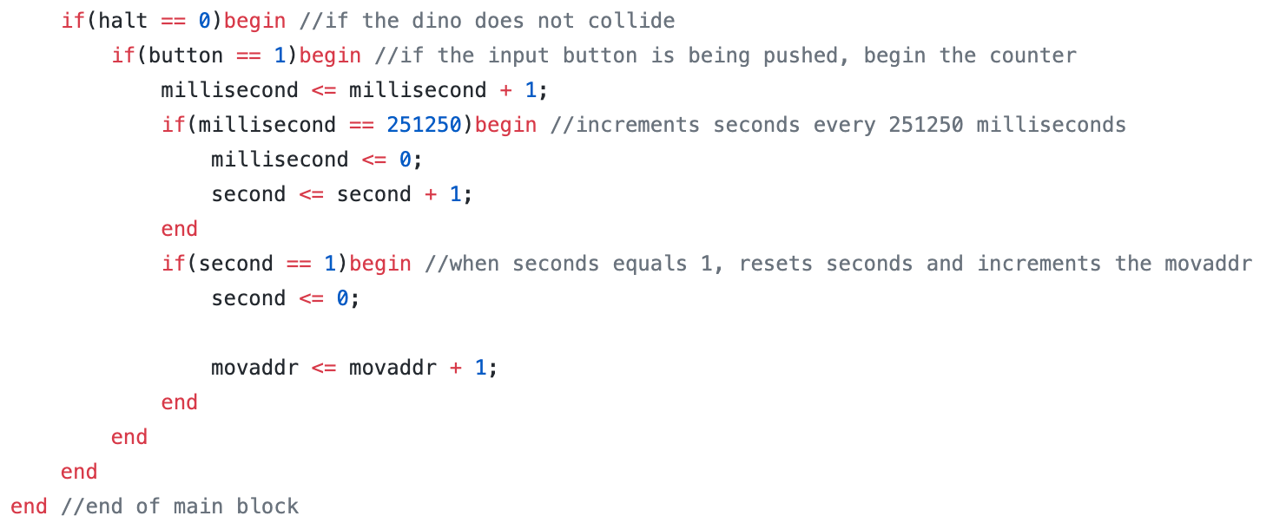
Code Snippet
How dino movement is handled in both our top.v module and our movement.v module:

Slide 8
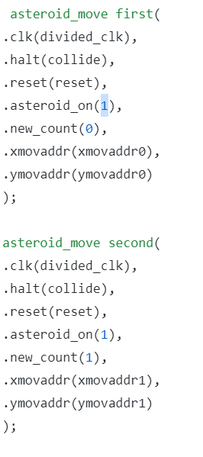
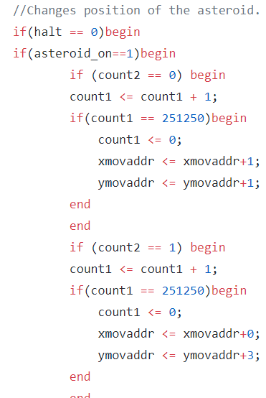
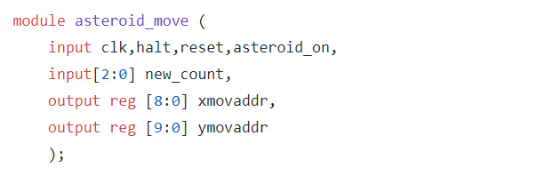
Some More Code Snippet
Top.v
This is how asteroids are made and animated, they appear in a pseudo-random way
asteroid_move.v

Slide 9
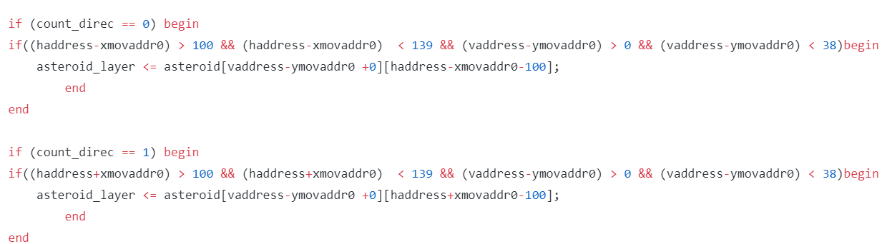
Even More Code Snippet
Top.v

Slide 10

Demo

Slide 11

Successes
Successful development of the game driven by a FPGA
Allowing the dino to move in all directions
VGA output of sprites and sprite animation
A pseudo-random number generator for the asteroid appearance
Interaction between dino and objects using collision logic

Slide 12
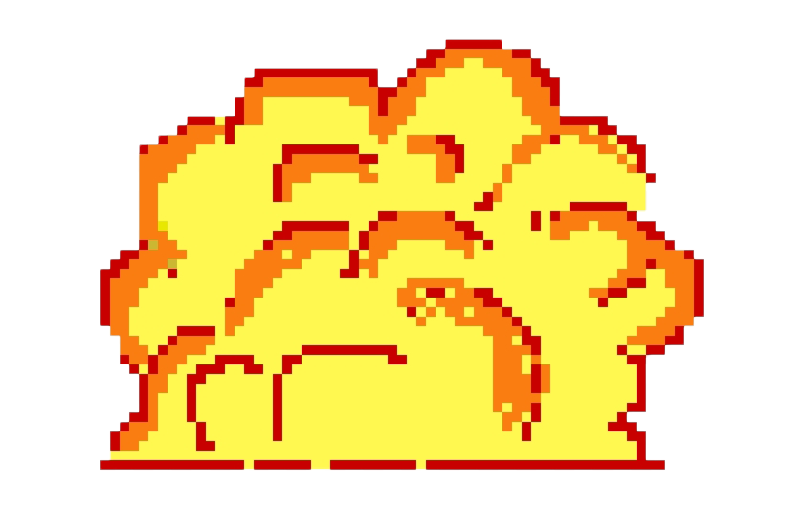

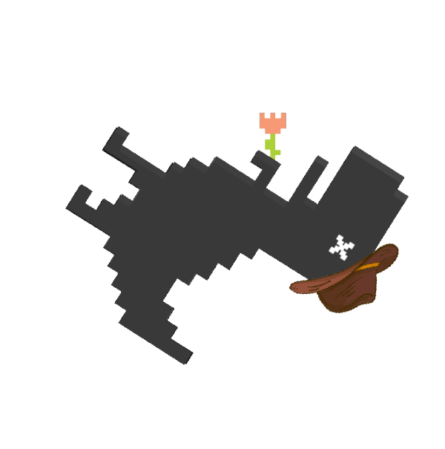
Failures
Unable to set the borders, so the dino can go off screen
Unable to layer the fire sprite on top of the cactus after collision
The score overflows after reaching the value 9999

Slide 13
